Slide 1
FOOD ORDER MANAGMENT SYSTEM

Slide 2
TEAM MEMBERS
1.
A.GANESH KUMAR
24KB1A0414
2.
B.GIRIDHAR
24KB1A0427
3.
S.PRANAY REDDY
24KB1A04W3
4.
P.PAVAN SHRASANTH
24KB1A04T2

Slide 3

INTRODUCTION

Slide 4
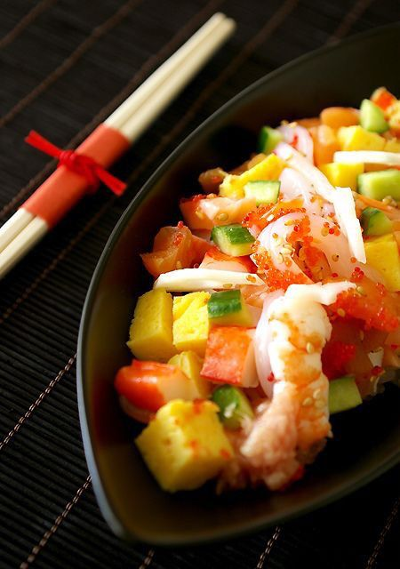
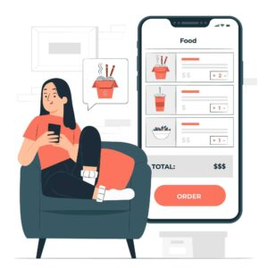
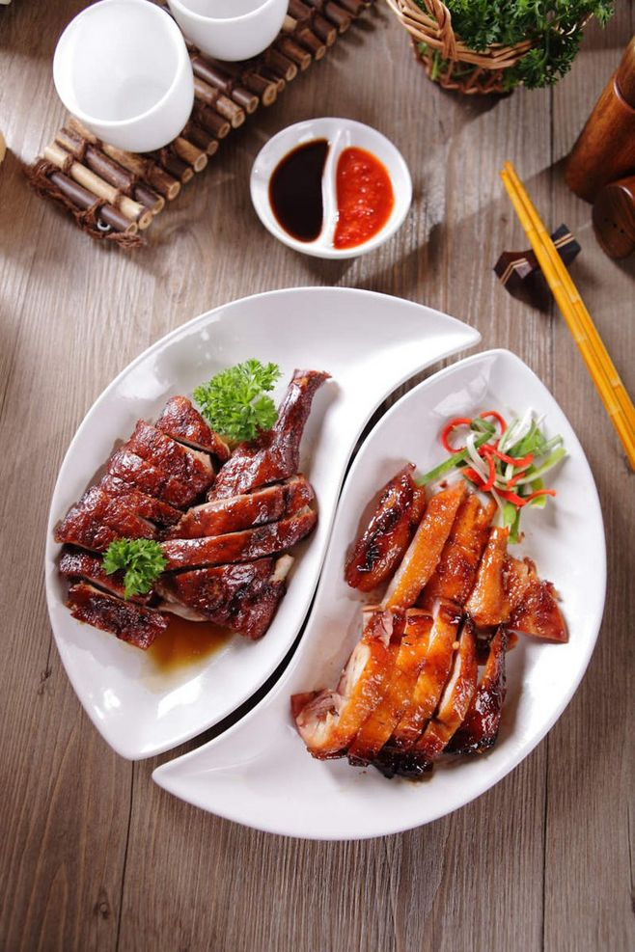
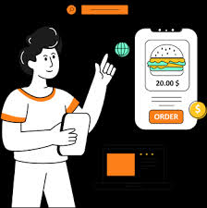
It automates tasks improves efficiency, and enhances the customer experience by offering convenience and real-time order tracking. Essentially, it bridges the gap between customers and food service businesses, making ordering easier and more efficient for everyone.
A Food Order Management System (FOMS) is a software solution designed to streamline the entire process of food ordering, from customer placement to delivery or pickup

Slide 5
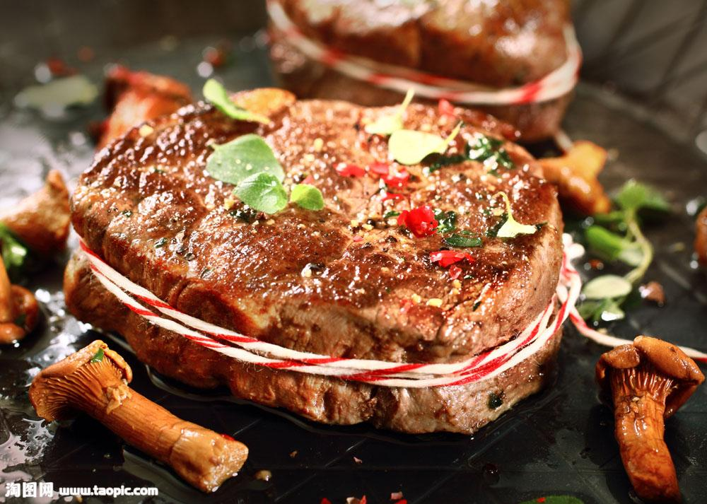
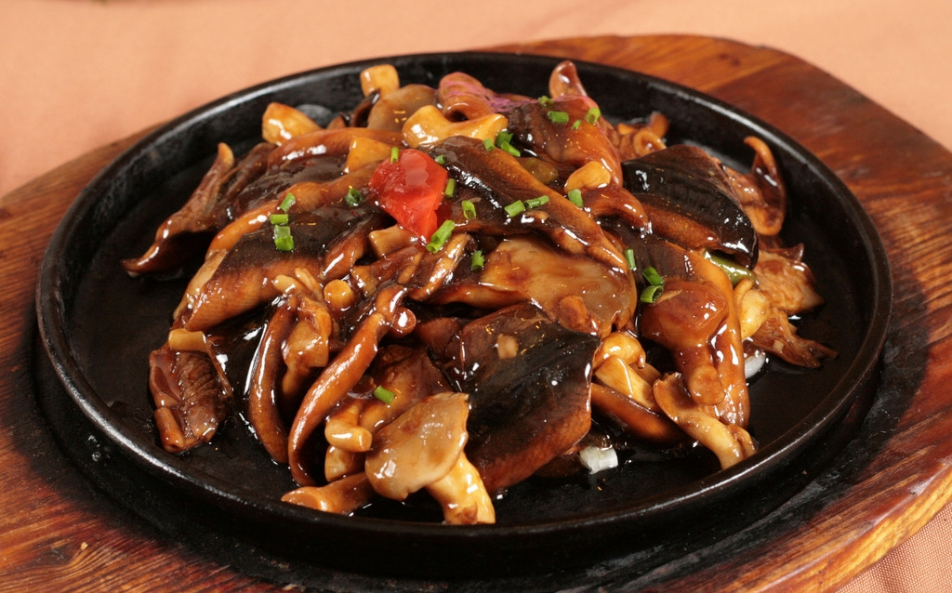
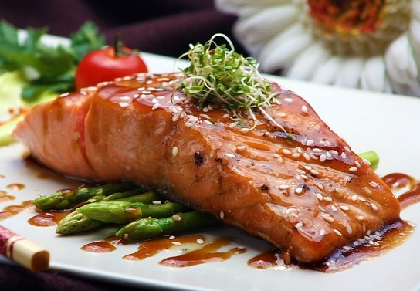
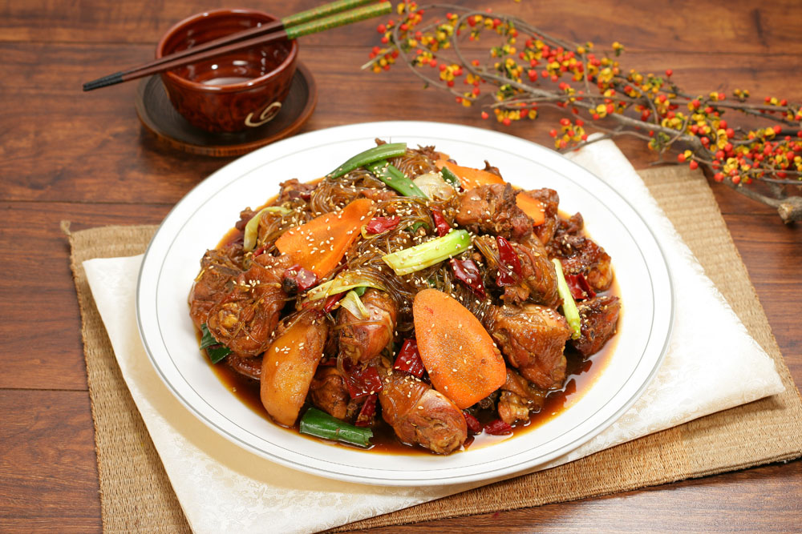
Menu Display
Pizza
Burger
Pasta
Fries
Cold Drink
PANEER TIKKA
CARD RICE
WATER BOTTLE
PANEER MALAI TIKKA
MASHROOM CARY
CHICKEEN 65
FRIE BIRYANI
CHICKEEN ROLL
EGG ROLL
CHOCLOATE ICEREAM
PULIHORA

Slide 6
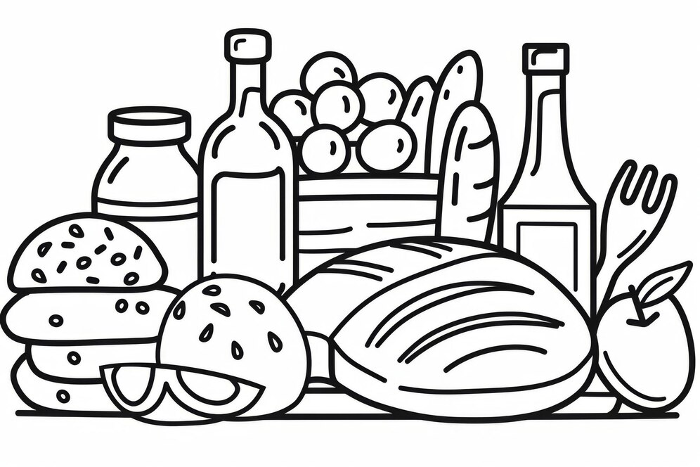


Customers can select items, modify quantities, and add special instruction
ITEAM
QUANTITY
PAYMENT
PANEER MALAI TIKKA
MASHROOM CARY
CHICKEEN 65
FRIE BIRYANI
CHICKEEN ROLL
EGG ROLL
CHOCLOATE ICEREAM
PULIHORA
Help's coustomer to place the required amount of food
Secure payment options can be integrated, allowing customers to pay online or via the POS.
Order Placement

Slide 7

Order Management

Slide 8
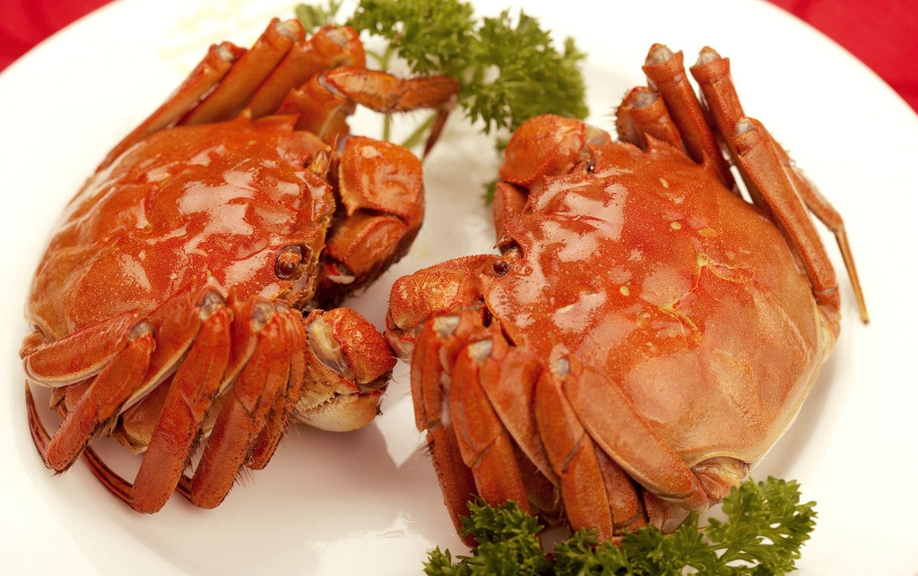

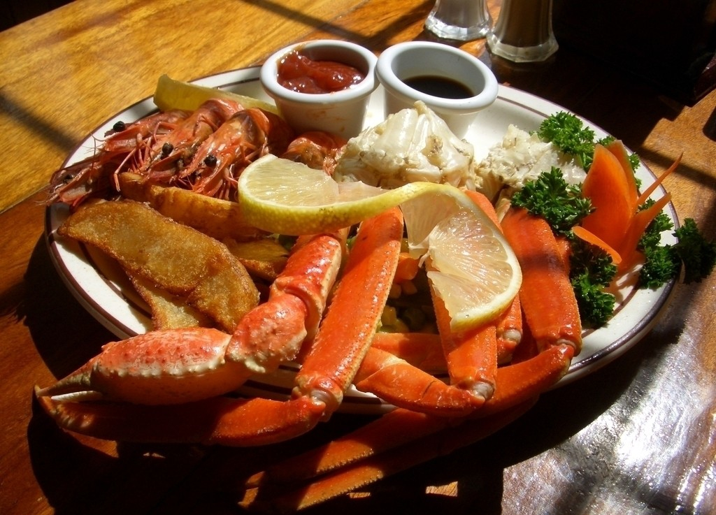
Point-of-Sale (POS)
reducing manual data entry and errors
Inventory Management
helping restaurants avoid running out of popular items

Slide 9

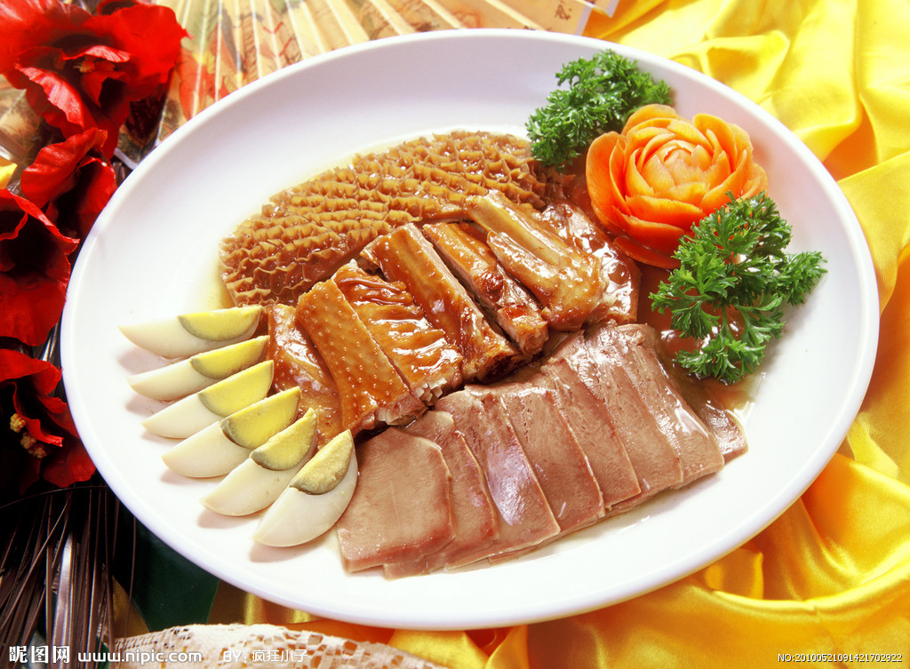
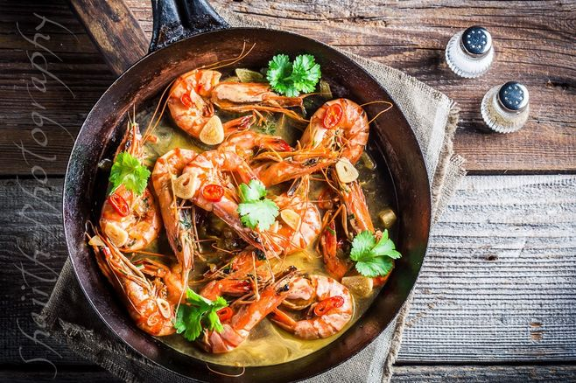
Real-time Order Tracking
Both the customer and the restaurant can track the order's progress, from confirmation to delivery.
Reporting and Analytics
provide data on sales, popular items, and customer preferences, helping restaurants make informed decisions.

Slide 10
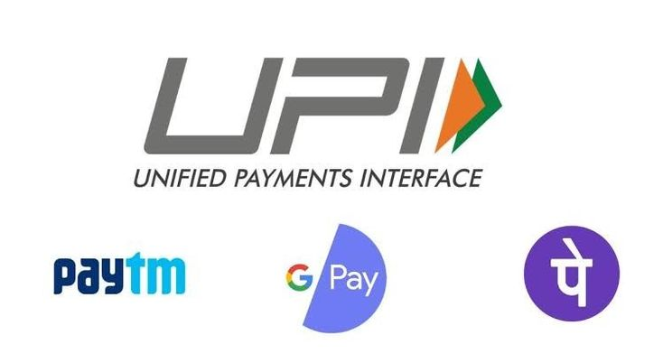
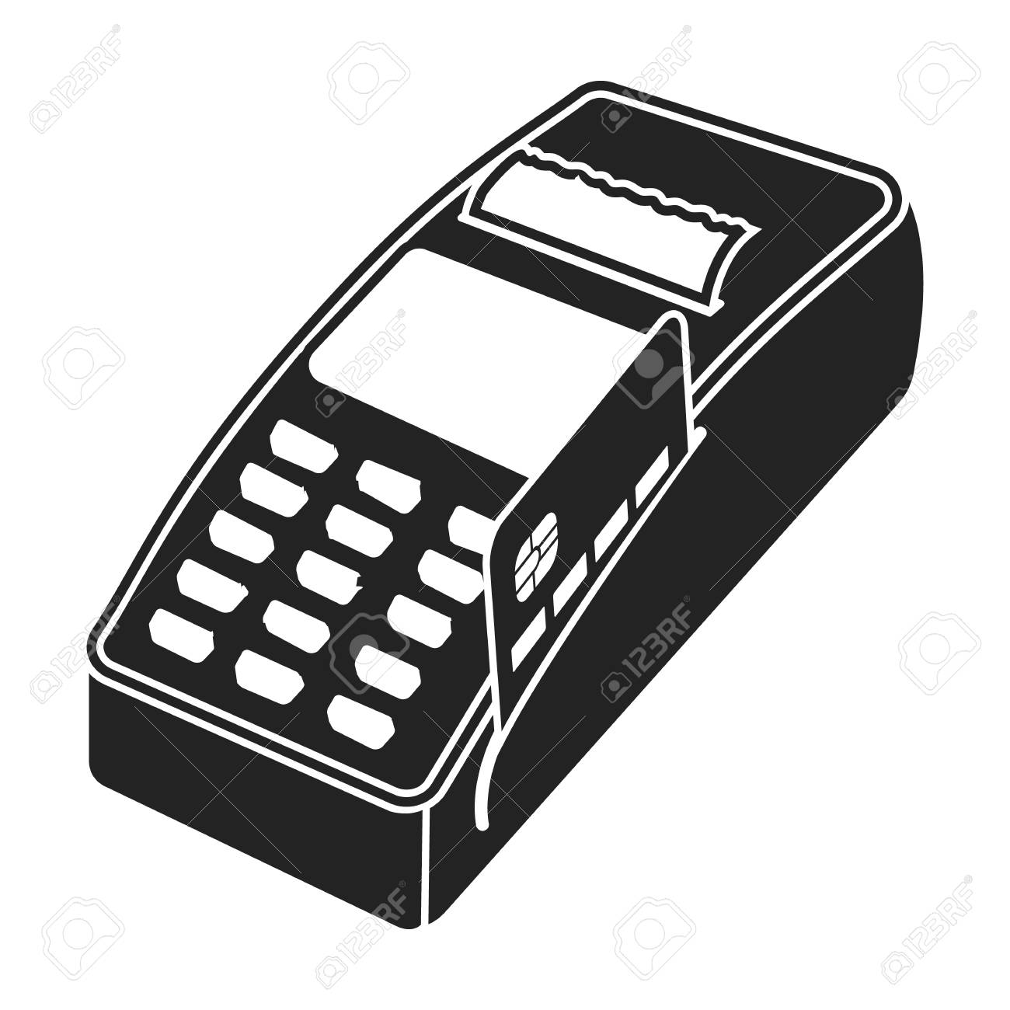
Payment Processing
Secure payment options can be integrated, allowing customers to pay online or via the POS.
online payment
Place on sale(POS)

Slide 11

CODING AND SYSTEM REQUIREDMENTS

Slide 12
SOURCE CODE
https://www.onlinegdb.com/

Slide 13
KEY FACTORS
float
void
for
if
return
break
while
#include
#define
struct
int
char
while

Slide 14
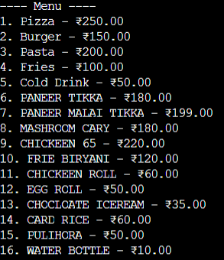
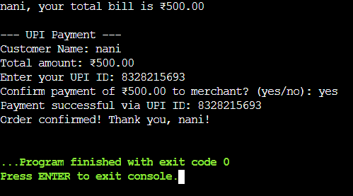
INPUT
OUTPUT

Slide 15

CONCLUSION

Slide 16

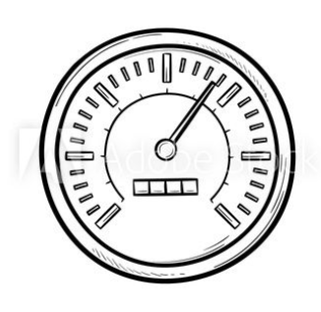


conclusion
online food ordering systems provide significant benefits for both restaurants and customers
Convenience:
SPEED
Mobile Ordering:
Increased Revenue:
Customers can order food from their phones or computers, eliminating the need to wait in line or speak to a waiter.
The ability to order and pay through mobile apps makes the process even easier.
Online ordering and delivery often lead to faster order fulfillment times.
Expanded reach and higher order volumes can result in increased profits.

Slide 17
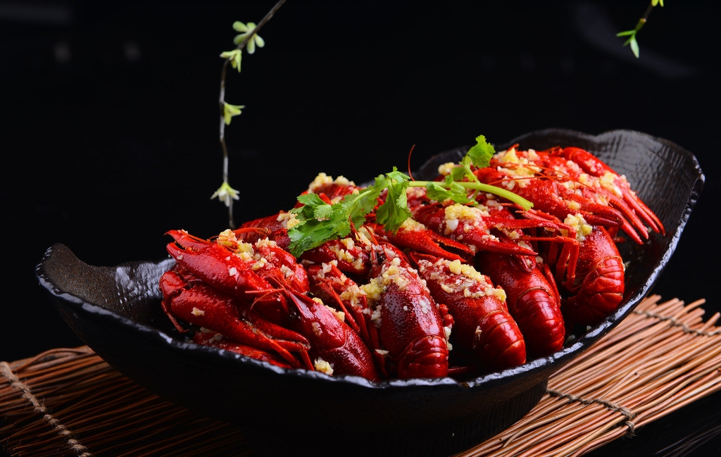
Benefits for Customers
Order Tracking: Customers can track their order progress in real-time, providing peace of mind and reducing the need for customer service inquiries
Variety of Payment Options: Online ordering systems often offer various payment options, including credit/debit cards, digital wallets, and UPI
Loyalty Program Benefits: Loyalty programs can reward customers with discounts, points, or other perks

Slide 18
THANK YOU

